Slide 1


POKEMON BATTLES
Midterm Presentation
Viano Arcery, Sean Block, Vishal Hada, Tobey Tan, Kyle Qin

Slide 2



HOW IT WORKS
Battle Focused, Fast-Paced Game Mechanism
Users:
Choose Pokemon Battle Loadout
Choose Moves for Each Pokemon in Battle Loadout
Gain Points from Battles
Pokemons:
Gain EXP and Level Up Based on Battle Results
Damage Dealt / Received
etc.
Learn New Moves As Leveling Up
New Pokemons:
Purchased in Shop with Points Gained As Level 1 Form
Notes:
Kyle

Slide 3
PROGRESS SO FAR…
React Framework / Front-End
HTML, CSS, BOOTSTRAP, JSX
Mobile First Design
Pages
Welcome
Login page
Home page
Concept for Battle
Friends
Party
Settings
Shop
Back-End
Json data for moves, types, Pokemon
Notes:
Sean

Slide 4
JSON Data
Combined data from from the Pokemon api
Only took the data we needed
Prevents unnecessary api calls
JSON files:
Pokemon
Moves
Types
Notes:
Tobey & Viano

Slide 5

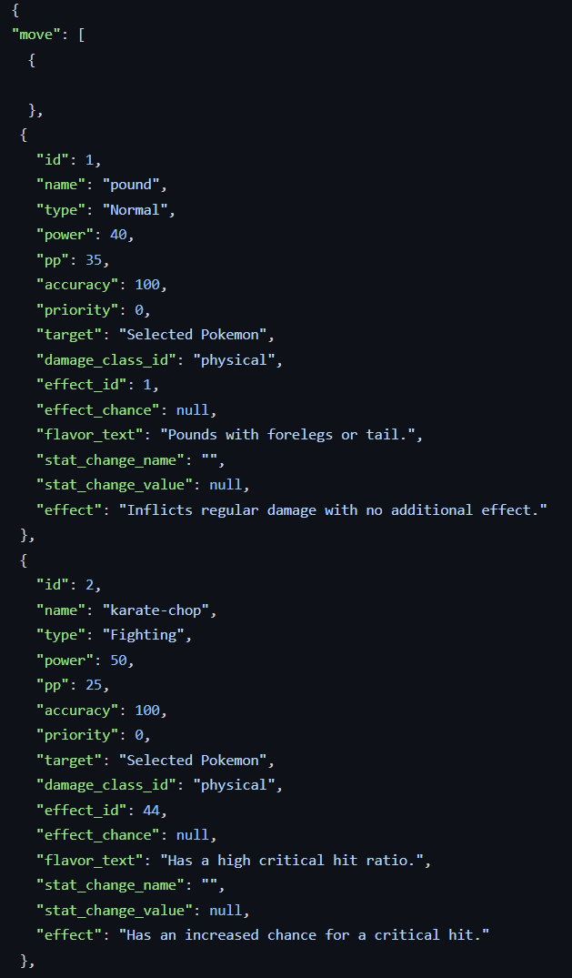
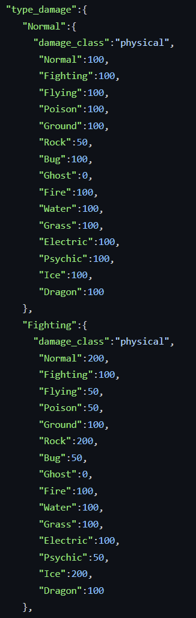
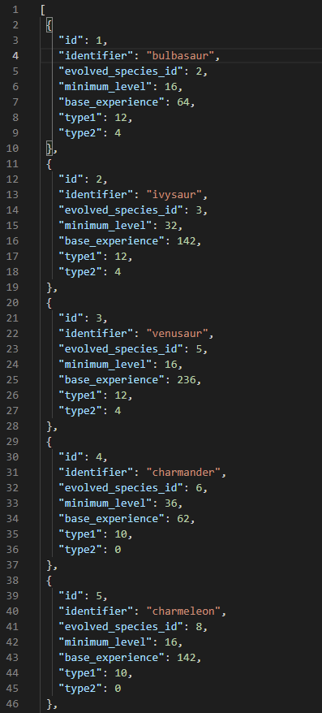
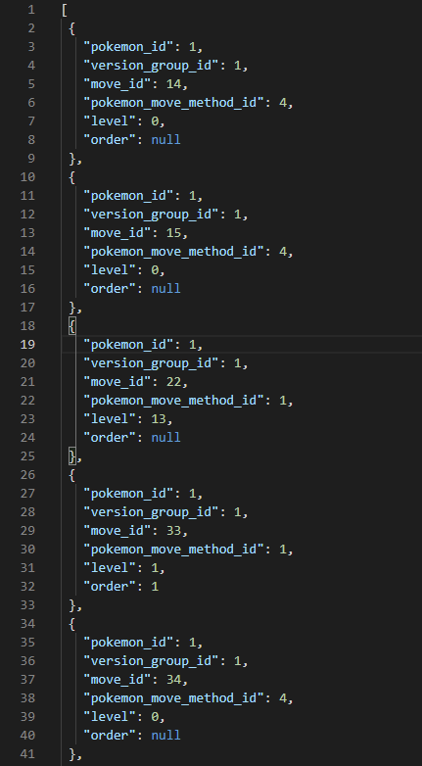
Moves: Types: Pokemon: Pokemon moves:
Notes:
Viano & Tobey

Slide 6
IT’S..
..DEMO TIME

Slide 7
Project timeline
Project Initiation
Basic game mechanics
Backend JSON
Front end/UI design
Back-End / Socket.io
Rest API
Database/Firebase(login)
✅
✅
✅
✅
Notes:
Vishal

Slide 8


Thank You!
Any questions?

